Slide 1

STATATHON 2025
DEDSEC
Problem Statement ID: 3
Problem Statement Title: AI-Powered Smart Survey Tool for Survey Data Collection
PS Category- Software
Team ID: 5063
Team Name (Registered on portal): Dedsec

Slide 2


AI-Enabled Semantic Search for NCO
DEDSEC
Proposed Solution 🛠
How It Solves the Problem
Why it's unique
📂Structured Data: Convert NCO-2015 to JSON/CSV, retain hierarchy.
🤖Semantic Search: BERT/Sentence-BERT + FAISS for meaning-based retrieval.
🔄 Synonym Mapping: Handle terms like “tailor” ↔ “sewing machine operator”.
🌐 Multilingual & Voice: Hindi + regional language + voice queries.
📊 Admin Tools: Data updates, synonym control, search analytics.
🧠Understands Context – Works without exact keywords.
⚡ Faster & Accurate – Instant retrieval vs manual PDF search.
🎯 Error Reduction – Confidence scores + fallback suggestions.
🙌 Easy to Use – No need for taxonomy knowledge.📈 Scalable – Ready for future updates & new languages.
🔍 Semantic Matching – Goes beyond keyword search.
Indian Context Tuning – Local job synonyms & variations
.📂 Hierarchy-Aware – Aligned to NCO structure.
🎙 Voice & Multilingual – Inclusive for diverse users.
🛡 Analytics + Admin Panel – Full MoSPI control & transparency.

Slide 3
TECHNICAL APPROACH
DEDSEC
Backend Setup : Node.js + Express / Django / Flask (based on choice)
Database Integration : PostgreSQL / MongoDB / MySQL + ORM (Prisma/Sequelize/Mongoose)
Authentication & Security : Passport.js / JWT / OAuth2
Frontend Setup : React + Vite / Next.js + Redux/Context API
UI/UX Implementation : TailwindCSS / Material UI / Custom SCSS
Core Feature Development : Backend + Frontend stack combined
API Integration : Axios / Fetch API
Testing : Jest / Mocha / Cypress
Deployment Setup : GitHub Actions / Vercel / Netlify / Docker
Final Deployment : AWS / Render / Railway / DigitalOcean

Slide 4
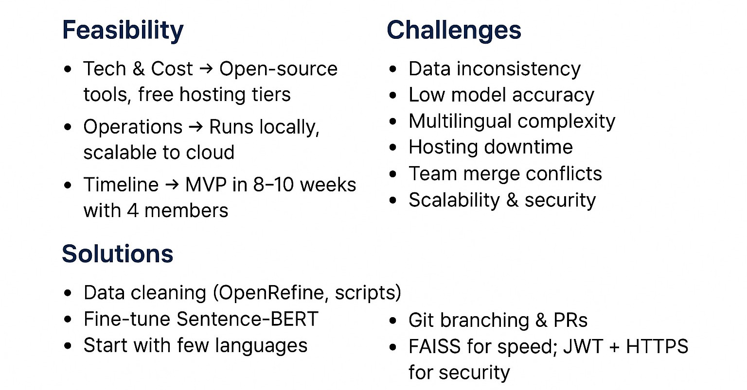
FEASIBILITY AND VIABILITY
DEDSEC

Slide 5

IMPACT AND BENEFITS
DEDSEC

Slide 6
RESEARCH AND REFERENCES
DEDSEC
Core Research & References Semantic Search Overview – Wikipedia
https://en.wikipedia.org/wiki/Semantic_search
Sentence-BERT (SBERT) Paper – arXiv
https://arxiv.org/abs/1908.10084
Job Title Semantic Classification – arXiv
https://arxiv.org/abs/1609.06268
VacancySBERT (Job/Skill Matching) – arXiv
https://arxiv.org/abs/2307.16638
Human Capital Ontology – arXiv
https://arxiv.org/abs/2507.21175
FAISS Semantic Search Tutorial – Walmart Tech Blog
https://medium.com/walmartglobaltech/transforming-text-classification-with-semantic-search-techniques-faiss-c413f133d0e2
Implementation Examples & GitHub ReposMohsanJoyia / Semantic-Search (FAISS + SBERT)
https://github.com/MohsanJoyia/Semantic-Search
Nandhagopalan / Semanticsearch (Semantic Retrieval System)
https://github.com/Nandhagopalan/Semanticsearch

